Slide 1
UNION Clause
- Morshedul Arefin

Slide 2
UNION / UNION ALL Clause
It is used to combine the results of two or more SELECT statements into a single result set.
The SELECT statements must have the same number of columns and the data types of the columns must be compatible.
UNION returns only unique rows.
UNION ALL allows duplicate rows to be present.

Slide 3
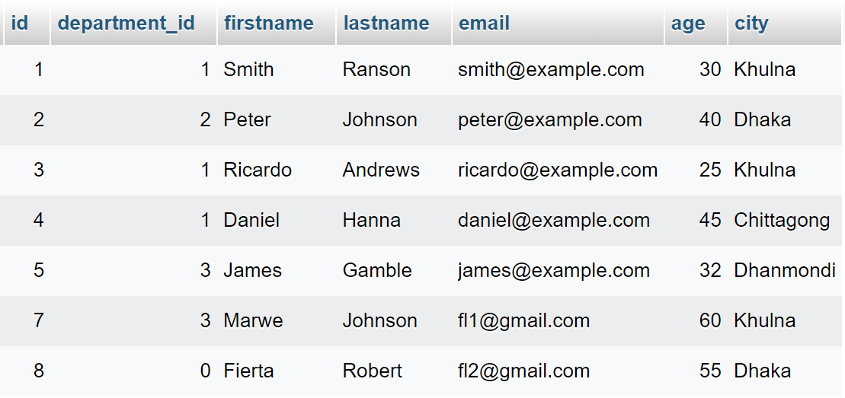
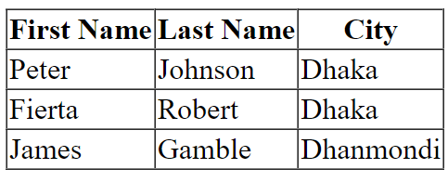
UNION / UNION ALL
$statement = $conn->prepare("
SELECT * FROM students WHERE city=?
UNION / UNION ALL
SELECT * FROM students WHERE city=?
");
$statement->execute(['Dhaka','Dhanmondi']);
$result = $statement->fetchAll(PDO::FETCH_ASSOC);

Slide 4
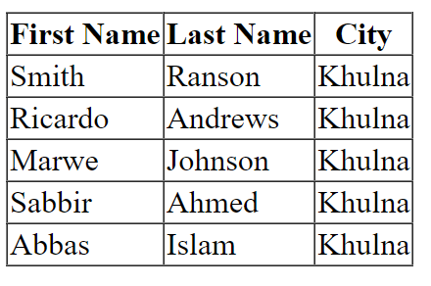
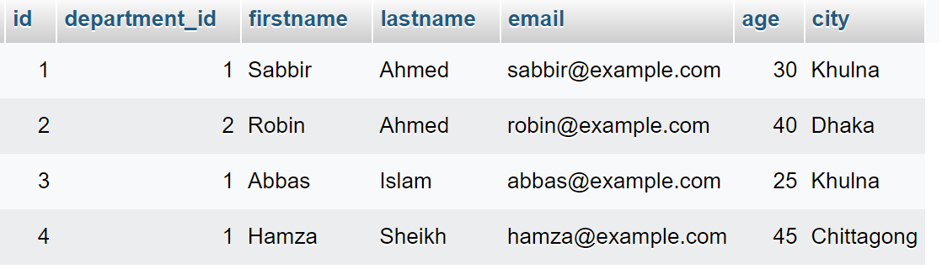
UNION / UNION ALL
$statement = $conn->prepare("
SELECT * FROM students WHERE city=?
UNION / UNION ALL
SELECT * FROM teachers WHERE city=?
");
$statement->execute(['khulna']);
$result = $statement->fetchAll(PDO::FETCH_ASSOC);

Slide 5
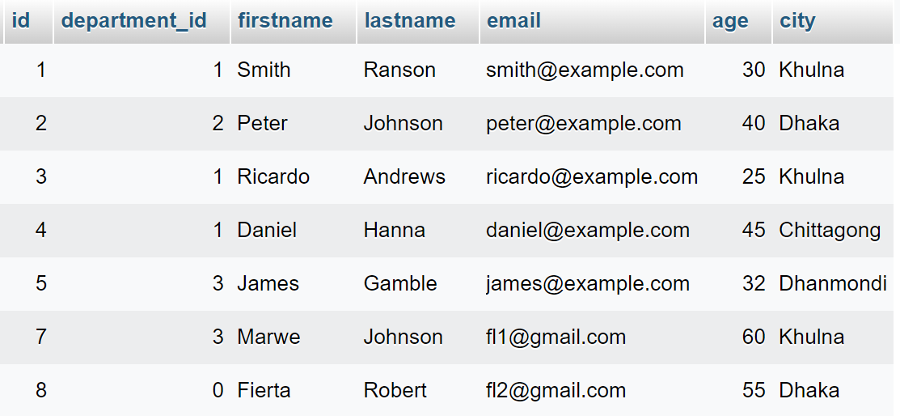
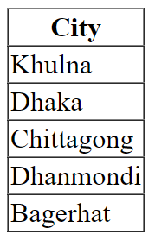
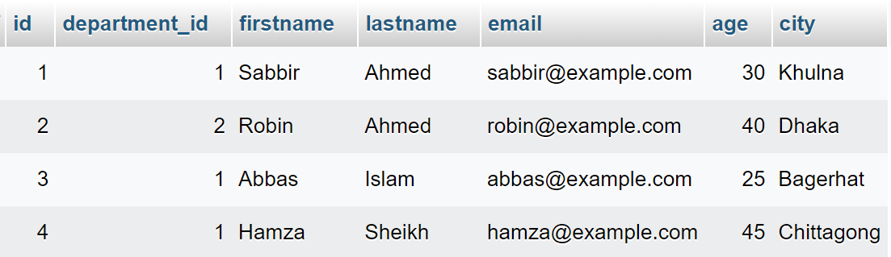
UNION Example
$statement = $conn->prepare("
SELECT city FROM students
UNION
SELECT city FROM teachers
");
$statement->execute();
$result = $statement->fetchAll(PDO::FETCH_ASSOC);

Slide 6
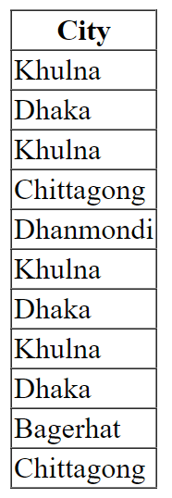
UNION ALL Example
$statement = $conn->prepare("
SELECT city FROM students
UNION ALL
SELECT city FROM teachers
");
$statement->execute();
$result = $statement->fetchAll(PDO::FETCH_ASSOC);

